Slide 1
What is a blocking factor? What is blocking
a blocking factor is a source of variability that is not of primary interest to the experimenter
blocking is the procedure by which experimental units are grouped into homogeneous clusters in an attempt to improve the comparison of treatments by randomly allocating the treatments within each cluster or 'block'
Example of a blocking factor: sex of a patient; by blocking on sex, this source of variability is controlled for, thus leading to greater accuracy

Slide 2
What is a factorial design? Why?
A factorial design is used to evaluate two or more factors simultaneously.
The treatments are combinations of levels of the factors.
advantages of factorial designs over one-factor-at-a-time experiments:
  more efficient
  allow interactions to be detected.
Nice example in V&R:p165

Slide 3
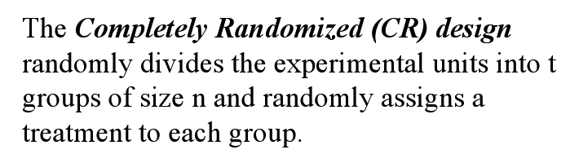
What is a completely randomized design?

Slide 4
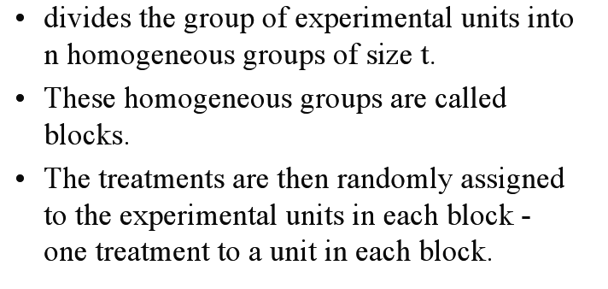
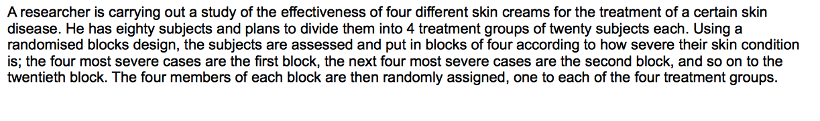
What is a Randomized Block Design?
subjects are matched according to a variable which the experimenter wishes to control

Slide 5
Was ist Reni
Eine suesse Maus

